Slide 1
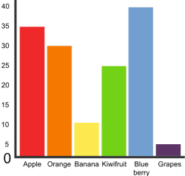
Subtracting Using
Bar Graphs

Slide 2
Favorite Fruits
If you see the words
HOW MANY MORE

Slide 3
Favorite Fruits
DON’T FORGET TO…
SUBTRACT!!!!

Slide 4
Favorite Fruits
Why?

Slide 5
Favorite Fruits
The question asks you to find
how much more one fruit was
voted for than another.
Basically, it is asking you to find the difference.
As you know when you
find the difference, you are
answering a subtraction
problem.

Slide 6
Favorite Fruits
Let’s Practice!

Slide 7
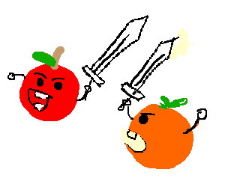
Favorite Fruits
How many more students liked
apples more than oranges?

Slide 8
Favorite Fruits
How many more students liked
apples more than oranges?
35
-30
5

Slide 9
Favorite Fruits
How many more students liked
blueberries more than grapes?

Slide 10
Favorite Fruits
How many more students liked
blueberries more than grapes?
40
-_5
35

Slide 11
Favorite Fruits
How many more students liked
oranges more than grapes?

Slide 12
Favorite Fruits
How many more students liked
oranges than grapes?
30
-_5
25

Slide 13
Favorite Fruits
How many more students liked
apples more than kiwi?

Slide 14
Favorite Fruits
How many more students liked
oranges than grapes?
35
-25
10

