Slide 1
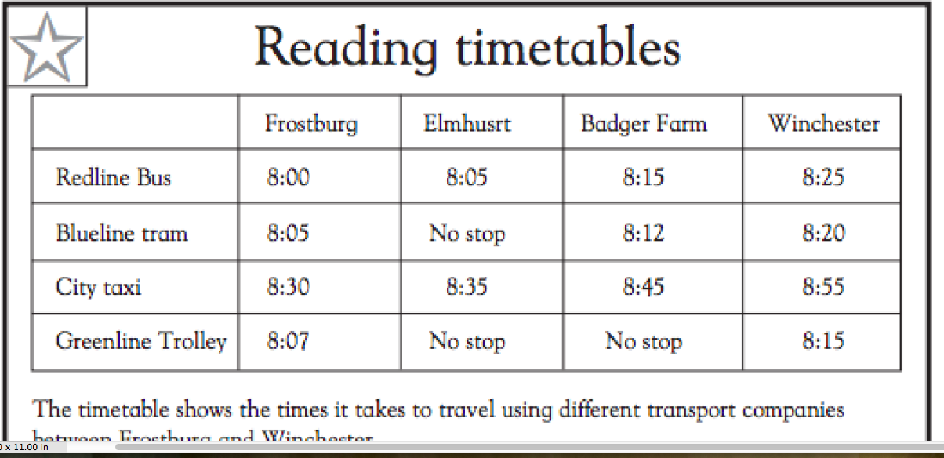

Slide 2
What time does the taxi arrive in Elmhurst?

Slide 3
What time does the City taxi arrive in Winchester?

Slide 4
How long does it take the City Taxi to travel from Frostburg to Elmhurst?

Slide 5
If I arrive at the stations in Frostburg at 8:03, which transportation companies could I ride on?

Slide 6
If I arrive at the station in Badger Farm at 8:25, which companies could I ride with?

Slide 7
If I left Badger Farm at 8:12, which company did I use to travel?

Slide 8
If I left Elmhurst at 8:35, which company did I use to travel?

